Slide 1
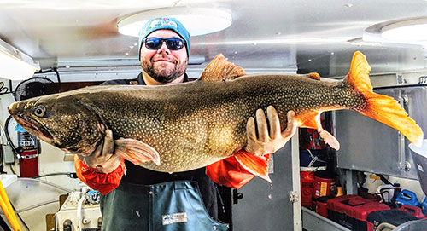
Lake Superior Fisheries Management Plan
Northland College
January 24, 2018

Slide 2
Lake Superior Fishery
Despite relatively small component of Lake Superior surface area, Wisconsin waters play a large role in the biology of the Lake
Complex fishery
Commercial
State and Tribal
Sport fishery
Charter, recreational, sustenance

Slide 3
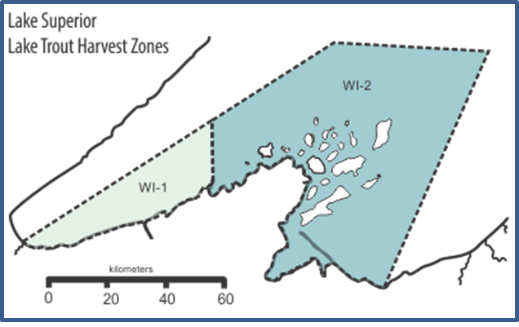
Diverse fishery requires diverse habitat
Key Areas
Chequamegon Bay
Apostle Islands
St. Louis River Estuary
Embayments (Bark, Siskiwit, Mauikwe)
Tributaries (Brule, St. Louis, Bad, Iron, etc.)
Refuges (Gull Island, Devil’s Island)
Restricted areas (Sand Cut, Hagan’s Beach, etc.)

Slide 4
Management challenges
Habitat loss
Non-native species
Increasing climate variability
Dynamics fisheries, shifting markets
Inter-jurisdictional management
Requires a plan to address complexity

Slide 5
LSFMP 1988 - 1998
Existing Lake Superior Management Plan was finalized in 1988
Many fish management goals have withstood the test of time; however,
Several fish management objectives may be outdated.
Need to update management plan to reflect current environmental conditions and stakeholder priorities and concerns.

Slide 6
LSFMP 1988 - 1998
Goals
Objectives
Tactics
Needed to Evaluate and Update
Notes:
Fisheries
Habitat
Social

Slide 7

LSFMP 1988 - 1998
Progress on objectives:
Goldilocks Scenarios
Need to update management plan to reflect current environmental conditions and stakeholder priorities and concerns.
Notes:
Some too high, some too low, some not specific or measurable, some just right.

Slide 8
LSFMP 2019 - 2028
Notes:
I changed end date so it is a 10 year plan rather than 11 year plan

Slide 9
Stakeholder engagement??
What level of involvement?
Public meetings, advisory group, how broad of a net to cast?
Bottom up vs. Top down?
WDNR provide framework for feedback or allow stakeholders to drive the conversation
How we address these issues will have major implications on timeline to completion

Slide 10
Key groups to engage?
Boat clubs
Charter fishers
Commercial fishers
Sport fishers
Tribal fishers
Tributary fishers
Rod and gun clubs
Red Cliff
Bad River
Law Enforcement
WDNR Office of Great Waters
Chambers of Commence
NGOs
Federal agencies
Others?

Slide 11
Stakeholder engagement options
Public meetings format
Stakeholder input via open meetings
WDNR incorporates input into draft plan
Several iterations prior to finalization

Slide 12
Stakeholder engagement options
Public meetings format
Stakeholder input via open meetings
WDNR incorporates input into draft plan
Several iterations prior to finalization
Combination of an advisory panel with regular updates through public meetings
Advisory panel and WDNR work to draft plan
Work together through iterative process until plan is finalized

Slide 13
Stakeholder Engagement Feedback
Desired approach?
Identify relevant stakeholder groups
Appropriate timeline?

Slide 14
Advisory Panel
Sent letters to 40 organizations and individuals
Diverse Stakeholders to represent diverse interests
26 agreed to participate
Monthly meetings to discuss goals and objectives

Slide 15
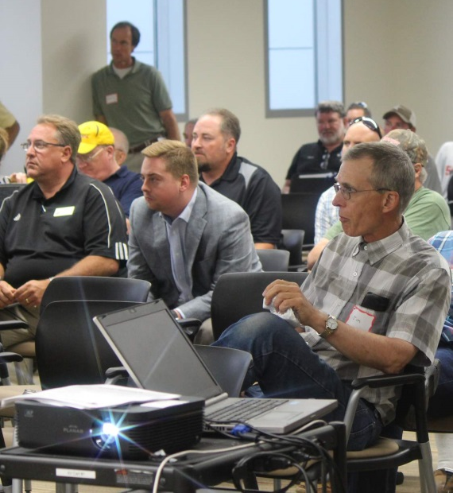
Advisory panel responsibilities
Advise WDNR on development of vision, goals, objectives, and tactics.
Represent viewpoint of stakeholder groups (fishing club, general angler, commercial fisher, etc.)
Provide bi-directional communication
between WDNR and public
Take accountability for final plan and
present with WDNR to public
Attend 6-8 meetings

Slide 16
Things to consider when identifying a good objective:
Attributes:
SMART
Specific
Measurable
Attainable
Relevant
Time-bound
Examples
Weak: I will be healthier.
Strong: I will to exercise 3 times a week for 30 minutes or more. I will eat vegetables at 2 meals a day.

Slide 17
Things to consider when identifying a good objective:
Attributes:
Socio-Ecological System
SMART
Specific
Measurable
Attainable
Relevant
Time-bound
Ecosystem
Habitat
Fish populations
Fishery
Economic value
Aesthetic value
Social value

Slide 18
Manager’s Models
Visual representation of how management functions within a system
Experience, connection to resource, values, biases and other factors guide each individual’s Model of Management
Integrate biological and societal knowledge into management decisions and actions

Slide 19
Developing a Lake Superior Management Model
Includes:
Ecological
Social
Economic
Political
Others…

Slide 20
Developing a Lake Superior Management Model
Includes:
Ecological
Social
Economic
Political
Others…
Key concepts:
Values
Impacts
Limits and capacity
Scale
Decision making

Slide 21
Desired Future Conditions
Goals
Management Concerns
Current and Historical Conditions
Stakeholder Concerns
Objectives
Research and monitoring
Tactics
Mitigating Actions
Impacts

Slide 22
Desired Future Conditions
Goals
Management Concerns
Current and Historical Conditions
Objectives
Stakeholder Concerns
Identified by
Research and monitoring
Tactics
Impacts
Mitigating Actions

Slide 23
Desired Future Conditions
Goals
Management Concerns
Current and Historical Conditions
Objectives
Stakeholder Concerns
Influence
Research and monitoring
Tactics
Impacts
Mitigating Actions

Slide 24
Desired Future Conditions
Goals
Determines
Management Concerns
Current and Historical Conditions
Objectives
Stakeholder Concerns
Research and monitoring
Tactics
Impacts
Mitigating Actions

Slide 25
Reflects
Desired Future Conditions
Dictates
Goals
Management Concerns
Based on
Current and Historical Conditions
Objectives
Stakeholder Concerns
Research and monitoring
Tactics
Impacts
Mitigating Actions

Slide 26
Desired Future Conditions
Goals
Management Concerns
Achieved through
Broadly defined goals necessary to achieve desire future condition that reflect the need for management and what we hope to accomplish through management actions
Current and Historical Conditions
Stakeholder Concerns
Objectives
Research and monitoring
Tactics
Impacts
Mitigating Actions

Slide 27
Desired Future Conditions
Goals
Management Concerns
Achieved through
Identify the ecological and sociological conditions that enable achievement of the goals and help focus specific management interventions and actions that should be taken
Current and Historical Conditions
Stakeholder Concerns
Objectives
Research and monitoring
Tactics
Impacts
Mitigating Actions

Slide 28
Desired Future Conditions
Goals
Management Concerns
Achieved through
Current and Historical Conditions
“What should we do?”
Stakeholder Concerns
Objectives
Research and monitoring
Tactics
Impacts
Mitigating Actions

Slide 29
Desired Future Conditions
Goals
Management Concerns
Current and Historical Conditions
Stakeholder Concerns
Objectives
Identifies
Evaluates
Research and monitoring
Tactics
Impacts
Mitigating Actions

Slide 30
Desired Future Conditions
Goals
Management Concerns
Accomplish
Current and Historical Conditions
Stakeholder Concerns
Objectives
Research and monitoring
Tactics
Impacts
Mitigating Actions

Slide 31
Desired Future Conditions
Goals
Management Concerns
Current and Historical Conditions
Stakeholder Concerns
Objectives
Research and monitoring
Tactics
Evaluate
Leads to
Mitigating Actions
Creates
Impacts

Slide 32
Desired Future Conditions
Goals
Management Concerns
Current and Historical Conditions
Stakeholder Concerns
Objectives
Research and monitoring
Tactics
Addressed by
Mitigating Actions
Impacts

Slide 33
Desired Future Conditions
Goals
Management Concerns
Current and Historical Conditions
Stakeholder Concerns
Objectives
Research and monitoring
Tactics
Mitigating Actions
Impacts

Slide 34
Basically,
Natural Resource Management is 90% managing the Public and 10% managing the Resource

